Slide 1
Chatbot Implementation For Ministry of Tribal Affairs (MoTA) Scholarship Website
Submitted By
Srijon Mallick (2022H110279P)
Research Practice- BITS G540

Slide 2
Problem Statement
In this project, our task is to build a conversational chatbot for MoTA (Ministry of Tribal Affairs) website [Click here to go to website]

Slide 3
Chatbot Introduction
There are several types of chatbots that can be developed depending on their functionality and purpose. Here are some of the most common types:
Rule-Based Chatbot
Generative Chatbot
Retrieval Chatbot
Hybrid chatbot

Slide 4
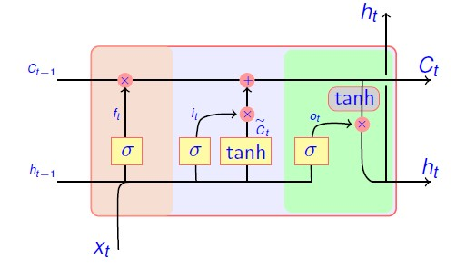
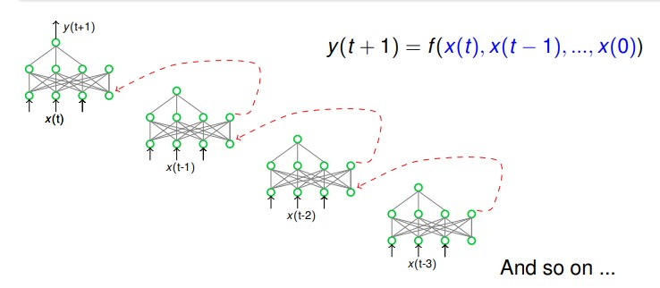
Methodology
In this project we have implemented retrieval based chatbots for MoTA website using LSTM (Long Short Time Memory) sequential network. Let’s introduce what is LSTM? – LSTM is advanced RNN (Recurrent Neural Network).
RNN
LSTM

Slide 5
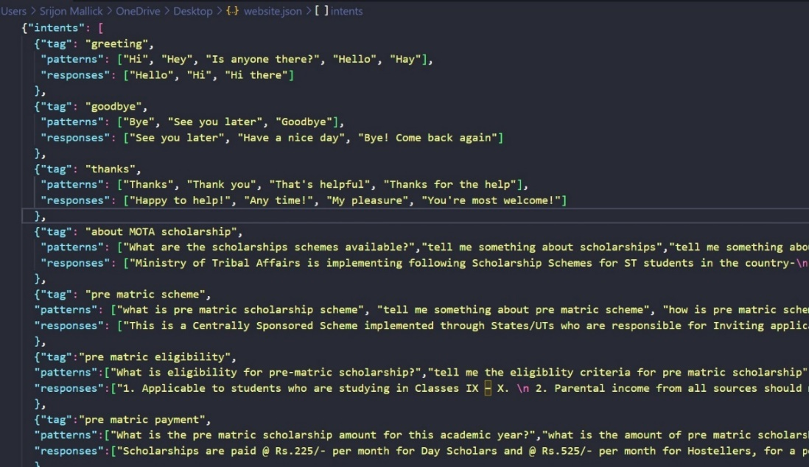
Implementation Details
Preparing Dataset:
We have collected text data from the website and made a json file which contains a set of pre defined question answers per one intent

Slide 6
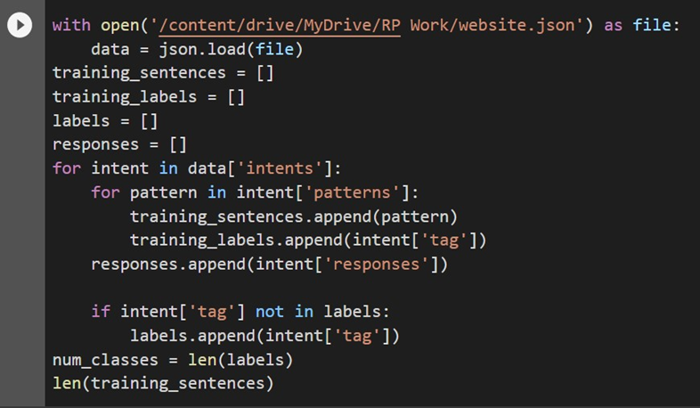
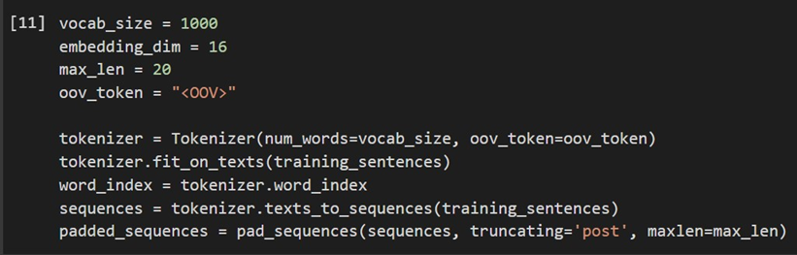
Implementation Details
2. Extracting training data & Pre-processing (text vectorizing):
In this step we have extracted all the possible questions mentioned in the dataset and their corresponding intent label (tag as in the dataset).

Slide 7
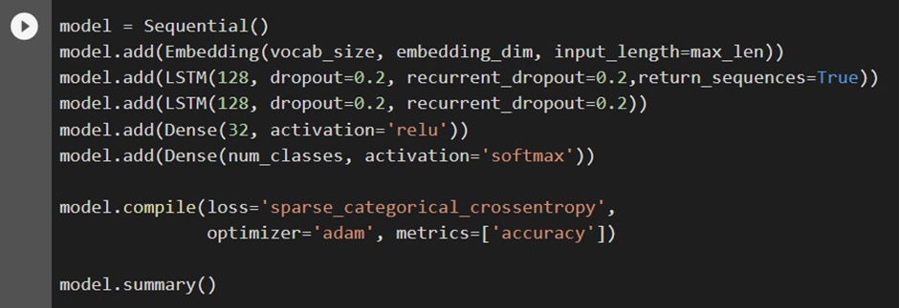
Implementation Details
3. Model Preparing:

Slide 8
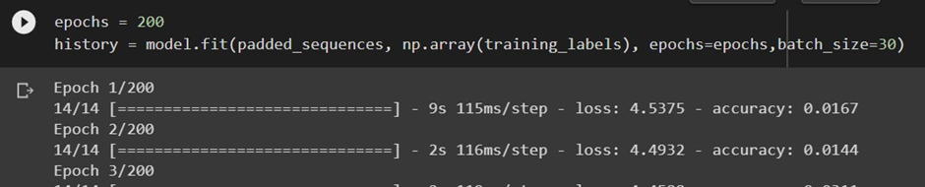
Implementation Details
4. Model Training:
Now the above model trained with the sample questions [‘training_sentences’] and their respective intents [‘tag’]. Code snippet is as below.
Here we have used 200 epochs as our dataset is small and to get training accuracy 96%. But the most disadvantage is that due to high epochs the model may get overfitted.

Slide 9
Implementation Details
5. Output (Deployed chatbot):
After training the model by our domain specific data, we saved the trained model. Now we have made one android app to make the chatbot usable for user. Below are the use cases for User & Admin.
User: User can do conversation with the chatbot and after completion of the conversation user can give rating to the particular conversation.
Admin: One admin can analyse all the conversations rating wise and can see the question answers asked against the particular conversation so that admin can analyse how the chatbot is performing.

Slide 10
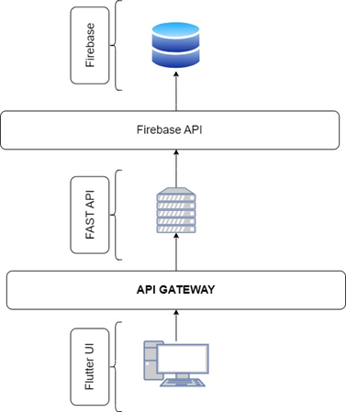
Implementation Details
Technology stack used in the application:
UI – Framework: Flutter- Dart
Backend: Python Fast API Server (As microservices)
Database: Firebase.
Application architecture is as below:

Slide 11
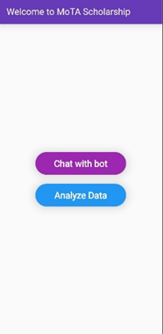
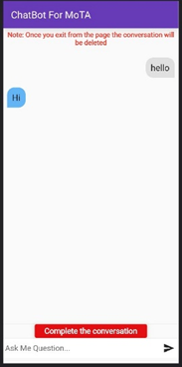
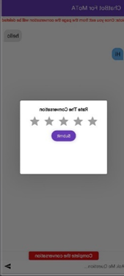
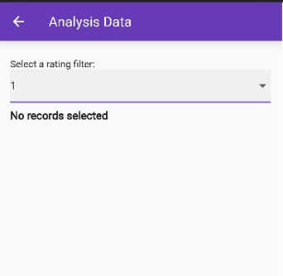
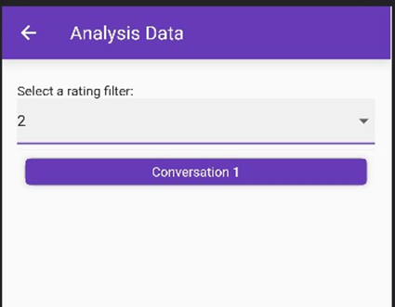
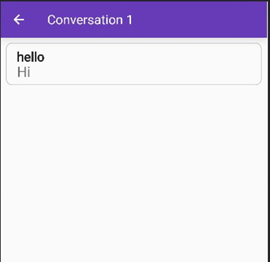
Implementation Details
UI – Flutter:

Slide 12
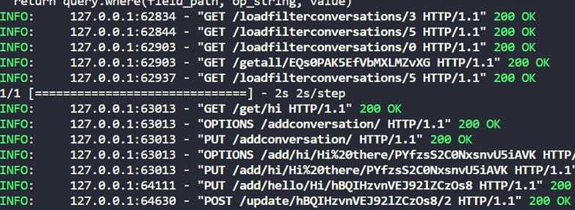
Implementation Details
Backend – FAST API
Backend is written in python that runs all the backend functions like fetching data from database and sending to user UI. Sample code snippet/APIs is given below.
@app.get("/get/{input}")
@app.put("/add/{question}/{answer}/{conid}")
@app.get("/getrating/{id}")
@app.put("/addconversation/")
@app.post("/update/{id}/{rating}")
@app.get("/getall/{id}")

Slide 13
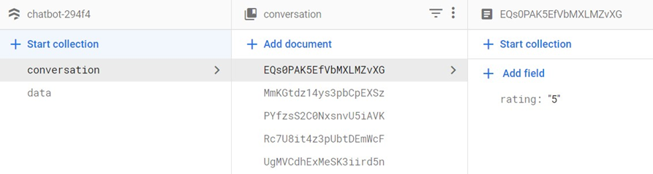
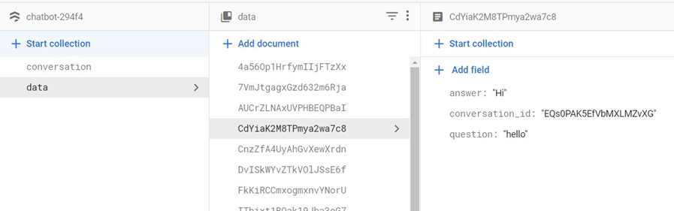
Implementation Details
Database – Firebase:
Data
Document id | Question | Answer | Conversation id
CdYiaK2M8TPmya2wa7c8 | Hello | hi | EQs0PAK5EfVbMXLMZvXG
Conversation
Document id | Rating
EQs0PAK5EfVbMXLMZvXG | 5

Slide 14
Limitations
This chatbot is trained with very a smaller number of data, that’s why some kind of model overfitting is there. So, it cannot handle any question that are in the known context but the user question has some difficult words.
If we give out of context question to the chatbot, instead of giving a smart answer like “I can’t understand your question”, the chatbot will give some known answer that is totally wrong.
This chatbot cannot handle the situation if user made a spelling mistake in asking question.

Slide 15
Future Scope
Our first target is to overcome all the limitations that the chatbot is currently having and secondly, we will make our chatbot more advanced. Our next move may be as follow:
Approach 1:
As we have small amount of data for our domain, then we will use pre trained model like – BERT, GPT which are already trained on a large set of English words. And we can easily fine tune the models according to our dataset using Hugging Face libraries.
In this approach, dataset will contain a set of question answers against one intent. By training the BERT model on our data, the model will tell the intent for user input and according to that intent the answers will be selected randomly.
Approach 2:
As approach 1, we will use the dataset that contains a set of question answers pairs under one intent. We will use pre trained model like BERT, GPT to train the same on our dataset by finetuning.
In this approach, the BERT or GPT model will give the intent of user input and then we will check the cosine similarity between user input and all the question under that intent. The most similar question will be selected along with its answer.

Slide 16
LIVE DEMO

Slide 17
THANK YOU

